Slide 1



GSM Based Smart Door Lock
Presented By- Md. Nafees Zaman
Sovon Mallick
Md MOAFFIQUL Alam
IoT and Robotics
Enhancing Digital Government and Economy Project(EDGE) Skill-IIT-JU

Slide 2
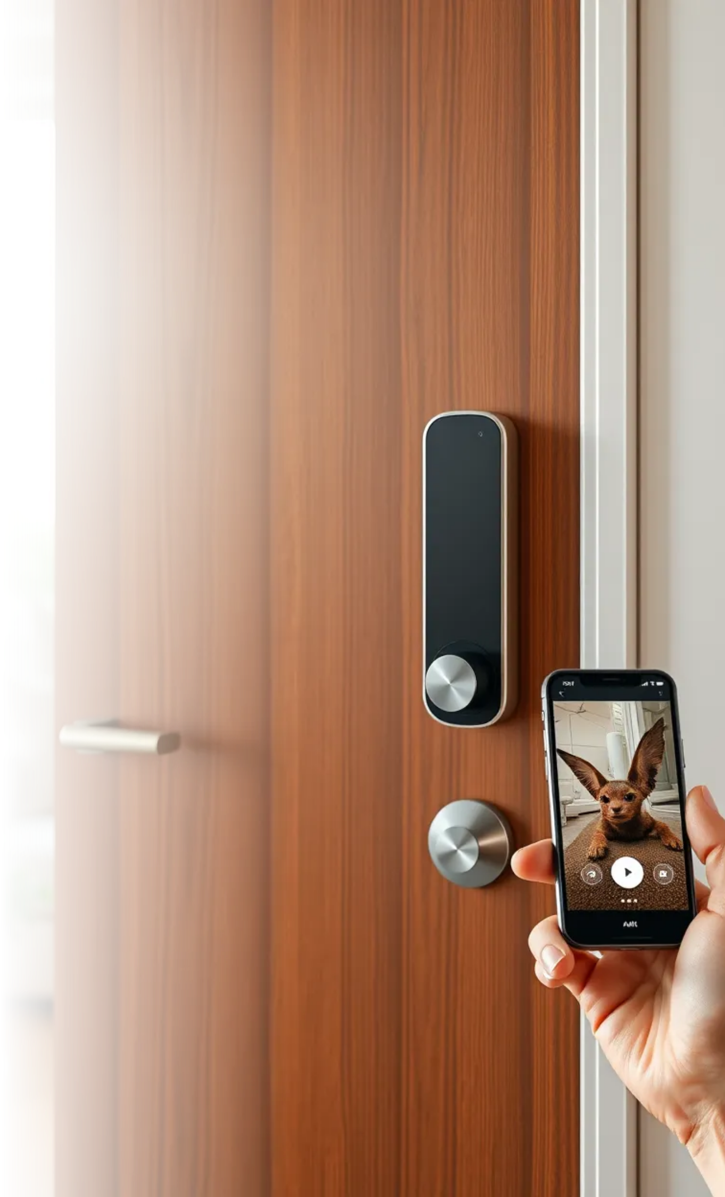
Project Overview
Remotely Operatable
Enhanced Security
IoT Application
Demonstrates practical IoT use in home automation.
Allows users to lock/unlock doors from anywhere.
Provides an additional layer of security for homes.

Slide 3
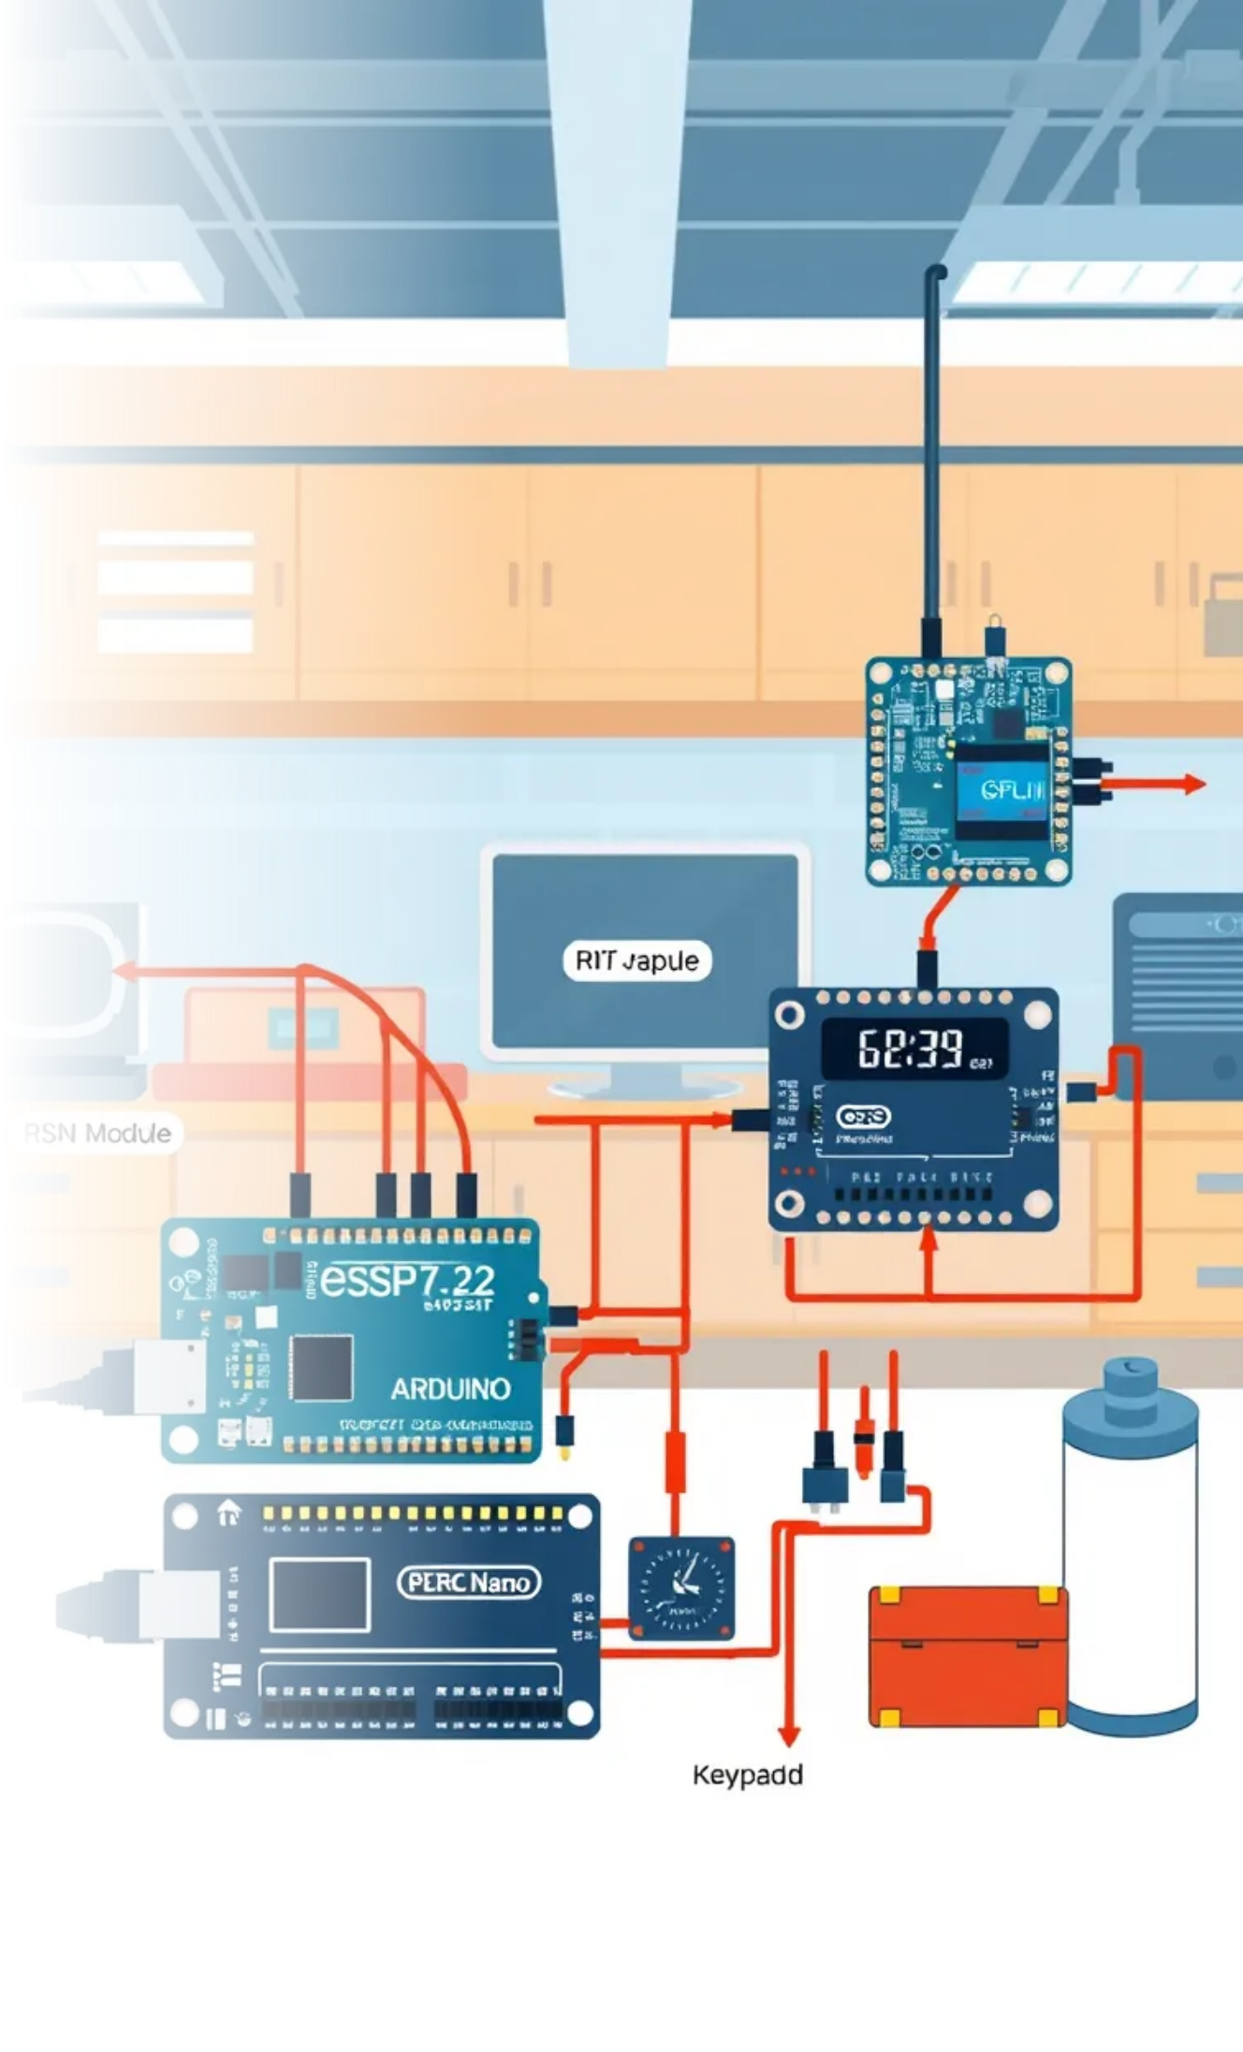
Key Components(1)
ESP-32
Arduino Nano
Relay Module
Acts as the main controller, enabling Wi-Fi and Bluetooth connectivity.
Used for processing and controlling the relay and other components.
Controls the solenoidal lock based on commands received.

Slide 4


Key Components(2)
GSM Module
Facilitates communication between the user and the locking system.
RTC Module
Keeps track of time for scheduled locking/unlocking.
Keypad
Allows manual input for unlocking the door.
Battery
Powers the entire system, ensuring functionality during power outages.

Slide 5
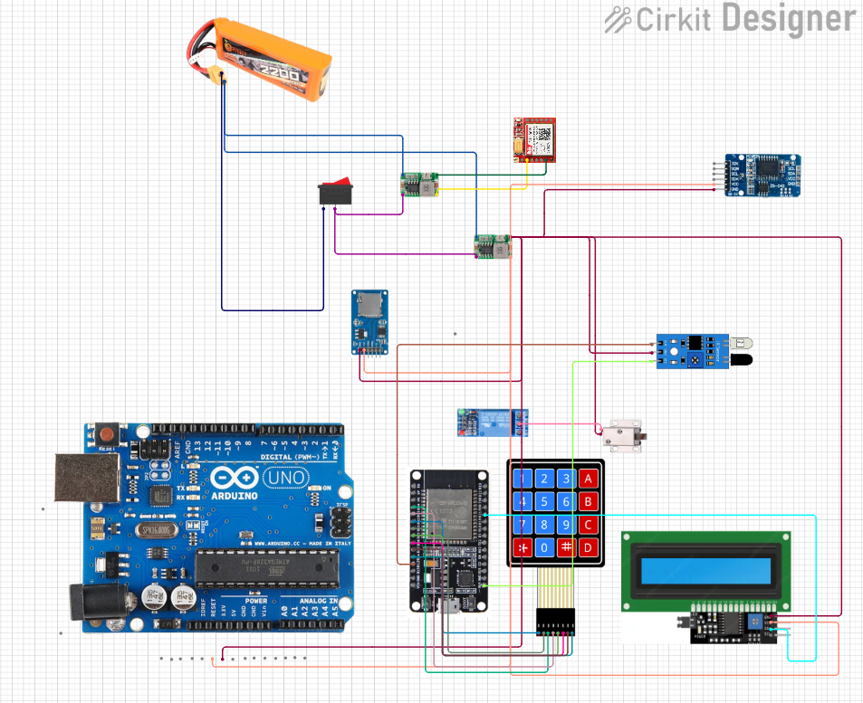
Circuit Diagram

Slide 6

Unique Features
Remote Access
Real-Time Alerts
User-Friendly Interface
Power Management
Enhanced Security
Users can lock/unlock their doors from anywhere using their mobile phones.
The system can send notifications to users about door status.
The keypad allows for easy manual operation.
Utilizes boost and buck converters for efficient power usage.
The solenoidal lock provides a robust locking mechanism.

Slide 7




Comparison with Existing Systems
Traditional Locks
Smart Locks
Cost-Effectiveness
Often require Wi-Fi, while this system uses GSM for broader accessibility.
Lack remote access and real-time notifications.
This project utilizes affordable components, making it accessible for DIY enthusiasts.

Slide 8


Technical Challenges
Integration of Components
Power Supply Management
Signal Reliability
Ensuring compatibility between various modules was crucial.
Balancing power requirements for continuous operation.
Ensuring consistent GSM communication in various environments.

Slide 9




Future Enhancements
Mobile App Development
Biometric Integration
Cloud Connectivity
Creating a dedicated app for easier control and monitoring.
Adding fingerprint recognition for enhanced security.
Enabling data storage and remote access through cloud services.

Slide 10


Team Information
Md. Nafees Zaman
GitHub: https://github.com/Md-Nafees-Zaman
LinkedIn: www.linkedin.com/in/md-nafees-zaman-
Sovon Mallick
GitHub: https://github.com/Sovon380
LinkedIn: www.linkedin.com/in/sovonmallick/

Slide 11
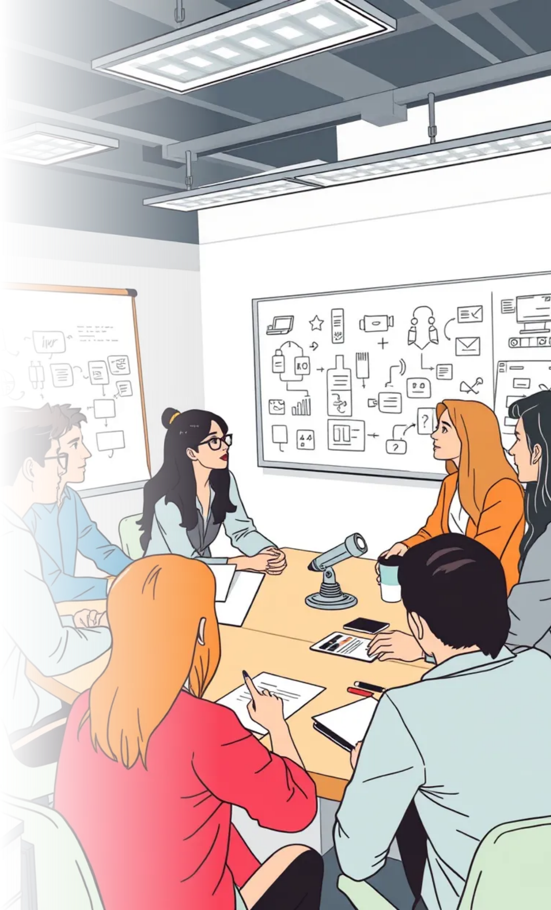

Q&A Session
1
Project Components
2
Design Choices
3
General Queries
Discuss the rationale behind design decisions.
Feel free to ask any other questions.
Inquire about the hardware and software used.

Slide 12


